Slide 1

Science A
Report Writing

Slide 2
Assessment
There are 2 laboratory sessions this semester. During each lab, you will perform 3 experiments.
Experiments 1 & 2 are assessed via an online quiz (5%)
Experiment 3 is assessed via a written report (20%)
The report is group assessed (so you only submit one report for your lab group), whilst the online quiz is individually assessed.

Slide 3

Writing a Report
Science laboratory reports have a general format which doesn’t vary too much.
Writing a science laboratory report is not difficult.
You write such a report to show that you can present data, and, more importantly, that you can interpret this data.

Slide 4
Writing a Report
It doesn’t matter whether your experiment gives you the results you expect, or not, you can still write a good report.
What matters is how well you interpret your results and how you use your scientific knowledge to explain what you have observed.
Your grade will also depend on how well you write your report using the appropriate scientific format and style.

Slide 5
Writing Style
Scientific reports should be written in the past passive voice, but what does this mean?
Firstly that you should be writing in the past tense, you are writing about something that has happened in the past. Rather than “add 20 mL of water to the test tube” you would say “20 mL of water was added to the test tube”.
Secondly it should be passive, you do not use words like “I” or “we”. Rather than “we measured the mass”, you would say “the mass was measured”.

Slide 6

Writing Style
Below are 3 ways of writing the same sentence, which is correct for a scientific report?
I poured 200mL of distilled water in a beaker.
200mL of distilled water was poured into a beaker.
Pour 200mL water in a beaker.
I measured the temperature with a thermometer.
Measure and write down the temperature.
The temperature was measured using a thermometer.
X
X
X
X

Slide 7
Introduction: Report Structure
A Scientific Report can be broadly broken down in to the following sections:
Abstract
Objective
Introduction
Apparatus
Procedure
Results
Uncertainty analysis
Discussion
Conclusion

Slide 8
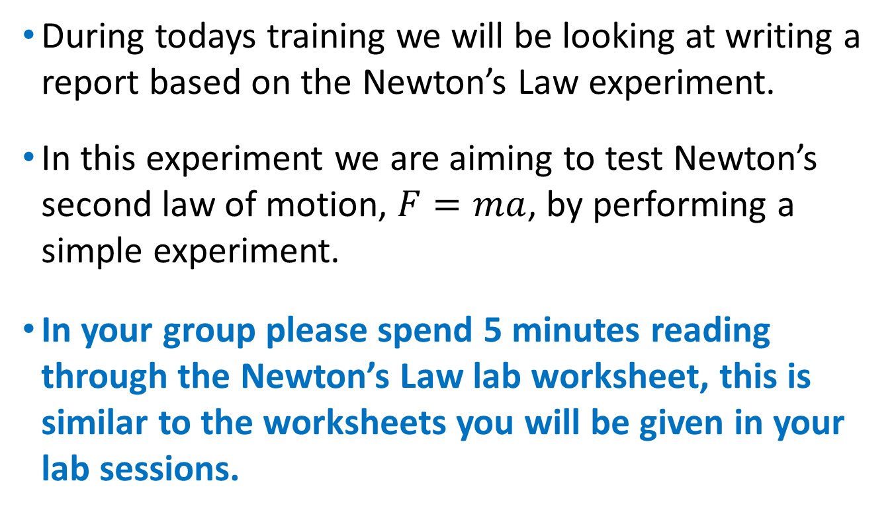
Lab Worksheet
During todays training we will be looking at writing a report based on the Newton’s Law experiment.
In this experiment we are aiming to test Newton’s second law of motion, $F=ma$, by performing a simple experiment.
In your group please spend 5 minutes reading through the Newton’s Law lab worksheet, this is similar to the worksheets you will be given in your lab sessions.

Slide 9
Report Template
For each report in this course you will be given a Report Template, this template is designed to guide you through the report writing process and to help you decide on what content to include.
The Sample Report Template you have been given has space provided for you to answer the various questions on the template itself.
By the end of this session you should have a completed report template which with a little extra work could be submitted as a good report.

Slide 10
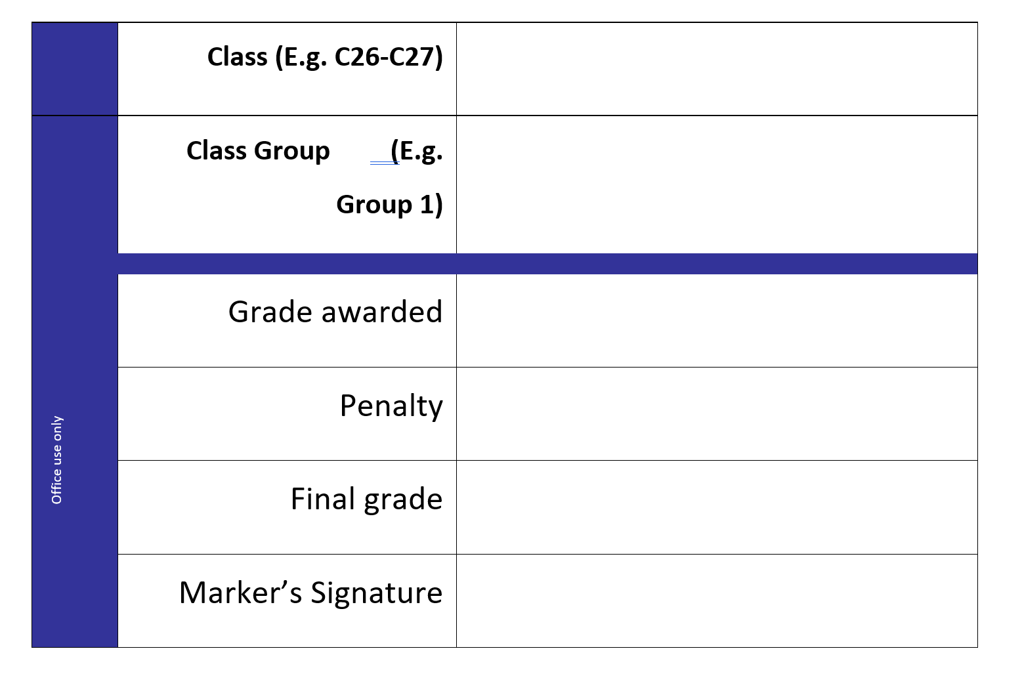
Cover Sheet
A21
This first thing to do is to complete the cover sheet by filling in your Class and Group numbers.
6

Slide 11

Report Format
Abstract
Objective
Introduction
Apparatus
Procedure
Results
Uncertainty Analysis
Discussion
Conclusion

Slide 12
Abstract
The abstract is a brief summary of the contents of the report and it should always appear at the beginning the report.
The abstract should;
state the hypothesis (scientific idea) being tested,
briefly describes the procedure(method used to test the hypothesis),
state the overall conclusion.
In other words, the abstract states the idea being tested (hypothesis), briefly describes what was done during the experiment and states what was discovered.

Slide 13
Abstract
Can we complete the abstract section for this experiment yet?
No! Since the abstract needs to contain a summary of the key points of the report we have to write the rest of the report first!
Whilst the abstract is the first paragraph in the report it must be written last, as we need to have completed all the other relevant section first!
We will come back to the abstract at the end of todays session after we have completed the other sections, then we should be able to complete it.

Slide 14
Report Format
Abstract
Objective
Introduction
Apparatus
Procedure
Results
Uncertainty Analysis
Discussion
Conclusion

Slide 15
Objective
The next section of the report template is the objective. In this section, you explain what you hoped to achieve in the experiment.
This should be a very easy section to complete as the objective for each experiment is written on the lab worksheet.
Complete the objective section by answering question 2) in the report template

Slide 16
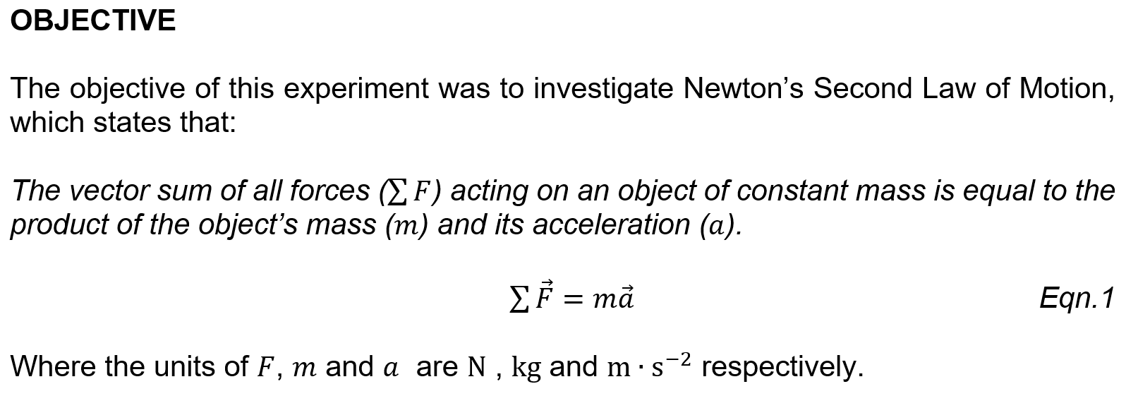
Objective: Example
State the objective of the experiment, the objective is always written on the student worksheet.
Note that you should number every equation in your report!

Slide 17
Report Format
Abstract
Objective
Introduction
Apparatus
Procedure
Results
Uncertainty Analysis
Discussion
Conclusion

Slide 18
Introduction
The introduction section is broken down in to 3 parts;
Background & Hypothesis
Derivation of equations
Assumptions
The first thing to write is the background of the experiment, where does our hypothesis come from?
In this experiment we are testing Newton’s second law of motion, so you can use your textbook or the internet to gather information.

Slide 19


Introduction
Note: When using the internet Wikipedia is not an acceptable source of information!
Also you must not copy and paste text directly from a website or copy word for word from a book, this is plagiarism.
All work that you submit should be your own, written in your own words.

Slide 20
Introduction
Once we have established the background for the experiment we should state the hypothesis.
In Science a hypothesis is defined as
“a belief regarding some aspect of the natural world (universe) which has not yet been proven true”.
You can find the hypothesis for the experiment on the laboratory worksheet.
Complete the first part of the introduction section by answering question 3) in the report template.

Slide 21
Condense This Information in to 1 Paragraph
Newton's Second Law of Motion.
According to NASA, this law states, "Force is equal to the change in momentum per change in time. For a constant mass, force equals mass times acceleration. If you double the force, you double the acceleration, but if you double the mass, you cut the acceleration in half.
Newton published his laws of motion in 1687, in his seminal work "Philosophiæ Naturalis Principia Mathematica" (Mathematical Principles of Natural Philosophy) in which he formalized the description of how massive bodies move under the influence of external forces. They have been found to give a complete description of the motion of all bodies across many orders of magnitude of mass, length and time.

Slide 22
Introduction: Example
INTRODUCTION
Isaac Newton proposed his three laws of motion in 1687. They have been found to give a complete description of the motion of all bodies across many orders of magnitude of mass, length and time. In this experiment, the acceleration of a vehicle was investigated to determine whether or not it can be accurately modelled using Newton’s second law of motion.
The introduction gives the background to the work, starting with the broad context of the study and leading up to the hypothesis (highlighted in blue).
Note: there is no one right answer as to what you should include in the background, as long as you have relevant content and include the hypothesis your answer is fine.

Slide 23
Introduction
The next part of the introduction is to derive the major equations we are using.
In other words we need to show mathematically were any equations we are going to be using come from.
When performing the derivation you should include comments and make references to any useful diagrams.
Your derivation needs to have enough detail and be well explained, such that, someone who is unfamiliar with the experiment can understand your logic.

Slide 24

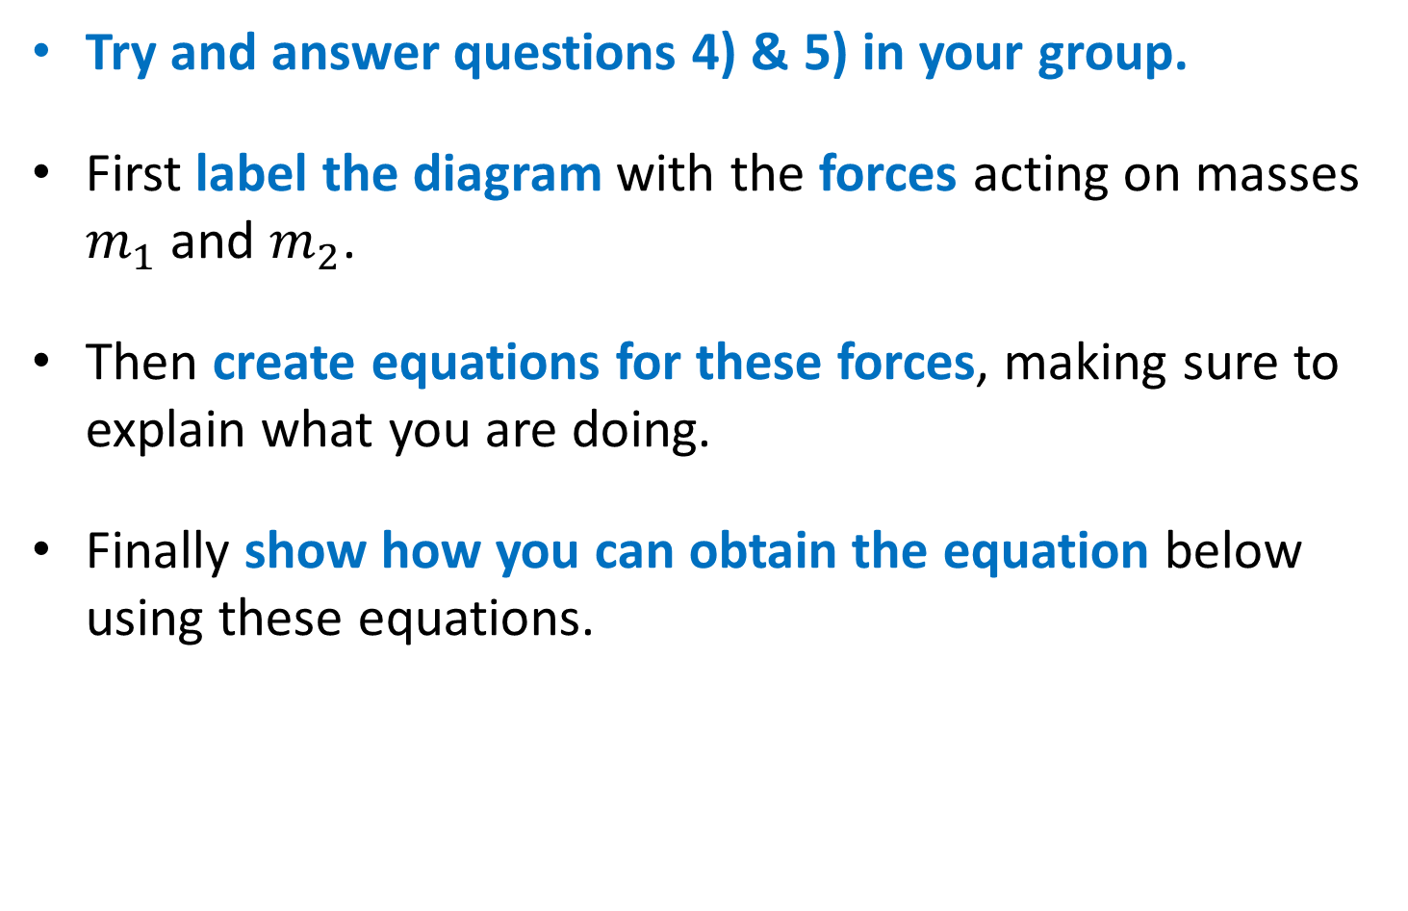
Introduction
Try and answer questions 4) & 5) in your group.
First label the diagram with the forces acting on masses $m_{1}$and $m_{2}$.
Then create equations for these forces, making sure to explain what you are doing.
Finally show how you can obtain the equation below using these equations.
$$a=\frac{m_{2}}{m_{1}+m_{2}}g$$

Slide 25
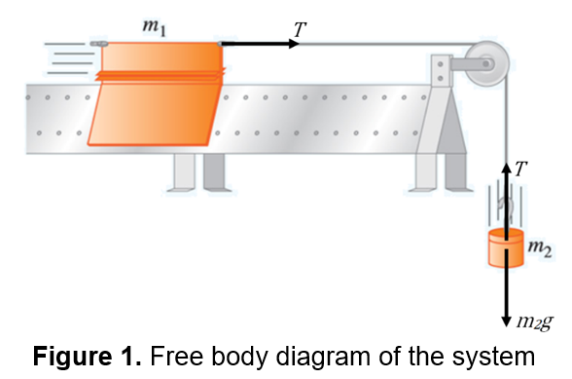
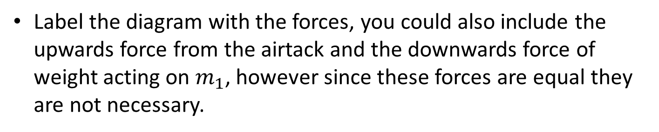
Introduction: Example
Label the diagram with the forces, you could also include the upwards force from the airtack and the downwards force of weight acting on $m_{1}$, however since these forces are equal they are not necessary.

Slide 26
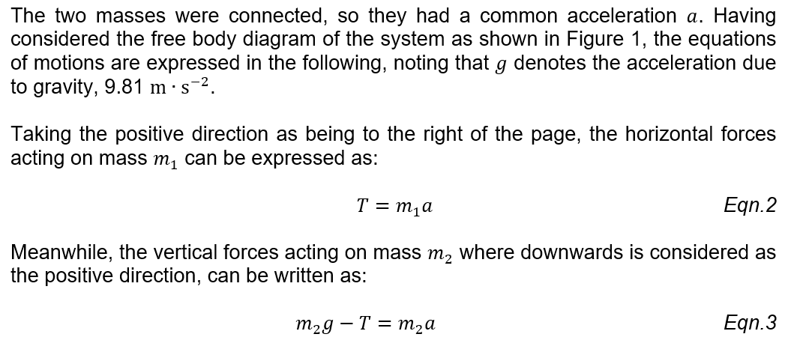
Introduction: Example
You can see that each equation is accompanied by a brief explanation.

Slide 27
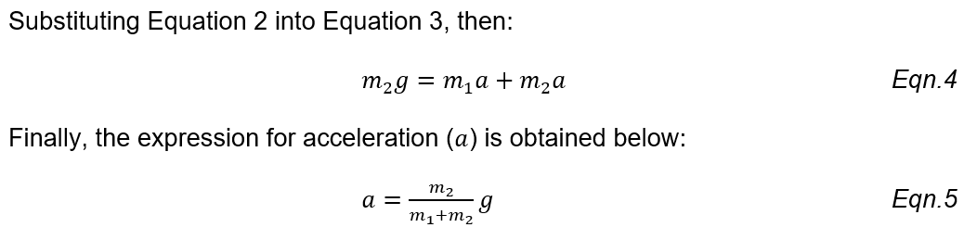
Introduction: Example
You can see that each equation is accompanied by a brief explanation.
All equations are given a number based on their order of appearance in the report.

Slide 28
Introduction
The final part of the introduction is to list the modelling assumptions.
Modelling assumptions are simplifications of the real world that allow us to make a mathematical model (our equation).
You can think of assumptions as additional factors that could affect the results of the experiment which are not present in our equation. What factors did we ignore when we made our equation?
Discuss in your group and try to come up with 3.

Slide 29
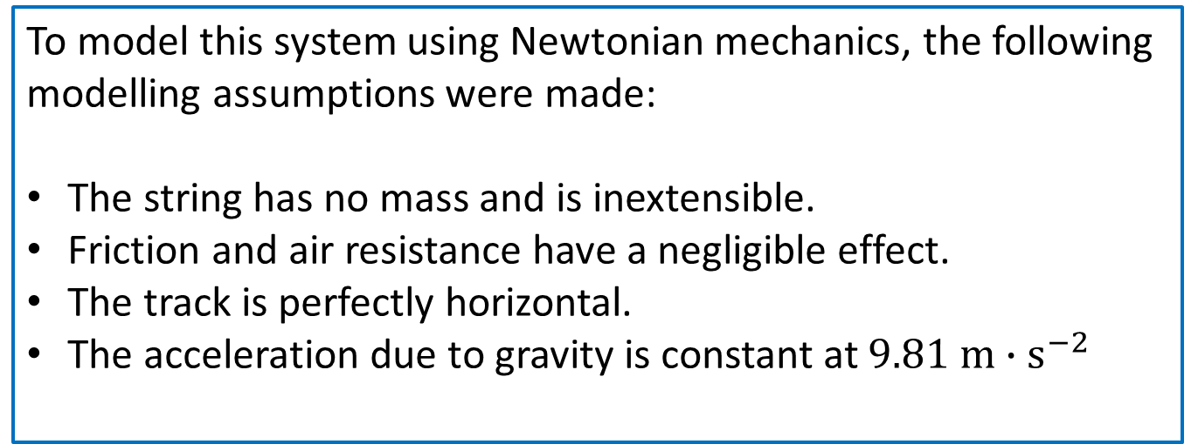
Introduction: Example
To model this system using Newtonian mechanics, the following modelling assumptions were made:
The string has no mass and is inextensible.
Friction and air resistance have a negligible effect.
The track is perfectly horizontal.
The acceleration due to gravity is constant at $9.81 m{∙s}^{−2}$
The assumptions are a very important part of the introduction as you will need to talk about your assumptions in the discussion and conclusion.

Slide 30
Report Format
Abstract
Objective
Introduction
Apparatus
Procedure
Results
Uncertainty Analysis
Discussion
Conclusion

Slide 31
Apparatus
The apparatus section of the report is simply a list of all the equipment used in the experiment in the form of bullet points.
You can find a list of equipment on the lab worksheet, but please note this does not always include every piece of equipment, it’s a good idea to write down what equipment you use as you do the experiment.
Answer question 7) on the report template.

Slide 32
Apparatus: Example
Apparatus:
An air blower A set of air track A vehicle Two light gates | A PC (computer) Six sets of weights A string An electronic balance
N.B. You do not need to include pictures of your apparatus.

Slide 33
Report Format
Abstract
Objective
Introduction
Apparatus
Procedure
Results
Uncertainty Analysis
Discussion
Conclusion

Slide 34
Procedure
The procedure section describes what you did during the experiment. It should contain enough detail that another scientist could repeat the experiment using your procedure.
The lab worksheet contains a list of instructions telling you what to do during the lab, if you just copy and paste this list you will score zero for this section.
You must rewrite the relevant instructions into the past passive voice, using your own words.

Slide 35
Past Passive Voice Reminder
Remember you should be writing in the past tense; you are writing about something that has happened in the past. Rather than “add 20 mL of water to the test tube” you would say “20 mL of water was added to the test tube”.
Secondly your writing should be passive, you do not use words like “I” or “we”. Rather than “we measured the mass”, you would say “the mass was measured”.
Answer question 8) as a group.

Slide 36
Procedure: Example
The apparatus was assembled accordingly as in Figure 1. Then, the air blower was connected to the air track. Prior to activating the air blower, the legs of the track were adjusted until the track was level, so that a vehicle placed on the track would remain stationary. The light gates were positioned alongside the track, with a fixed distance of 50 cm apart. The position of the second light gate was such that a vehicle (as shown in Figure 1) was subject to a constant accelerating force, i.e. the weight was still above the ground, when the end of the vehicle passed the second gate. The data logging software was then setup to record the acceleration between the 2 light gates.
Note that we don’t actually include all the details from instruction 3 in our procedure.

Slide 37
Report Format
Abstract
Objective
Introduction
Apparatus
Procedure
Results
Uncertainty Analysis
Discussion
Conclusion

Slide 38

Results
There are 3 parts in the results section of the report, in order they are:
Sample Calculations
Tables
Graphs

Slide 39
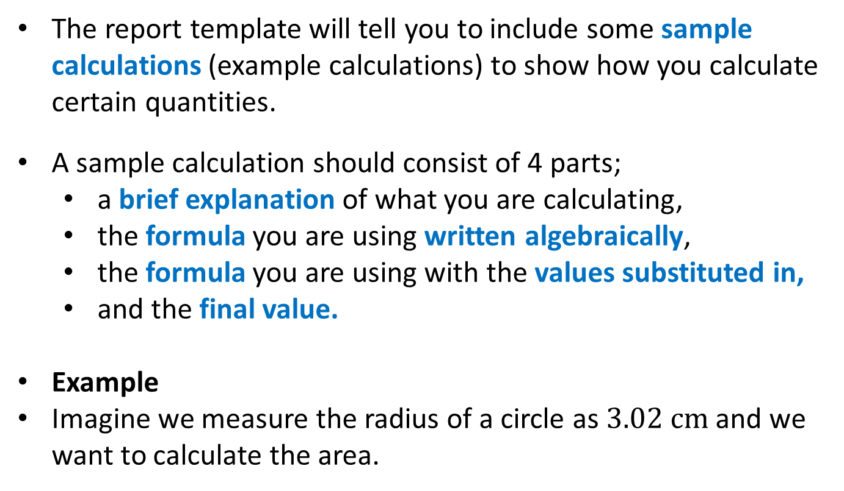
Results
The report template will tell you to include some sample calculations (example calculations) to show how you calculate certain quantities.
A sample calculation should consist of 4 parts;
a brief explanation of what you are calculating,
the formula you are using written algebraically,
the formula you are using with the values substituted in,
and the final value.
Example
Imagine we measure the radius of a circle as $3.02 cm$and we want to calculate the area.

Slide 40

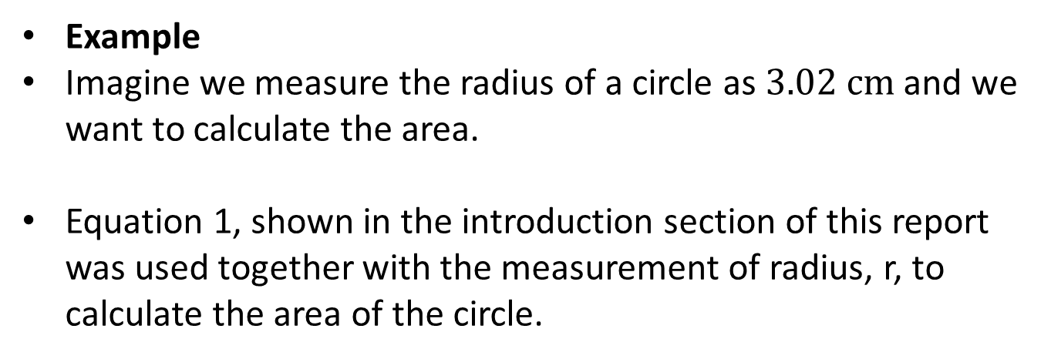


Results
Example
Imagine we measure the radius of a circle as $3.02 cm$and we want to calculate the area.
Equation 1, shown in the introduction section of this report was used together with the measurement of radius, r, to calculate the area of the circle.
$$A=πr^{2}$$
$$=3.14×{(3.02)}^{2}$$
$$=28.6 {cm}^{2}$$
Explanation
Formula with values
Final value
Formula

Slide 41



Results
Alternative
You can also set out your equations going down the page as well.
Equation 1, shown in the introduction section of this report was used together with the measurement of radius, r, to calculate the area of the circle.
Answer question 9) as a group.
Explanation
$$A=πr^{2}$$
Formula
$$A=3.14×{(3.02)}^{2}$$
Formula with values
$$A=28.6 {cm}^{2}$$
Final value

Slide 42
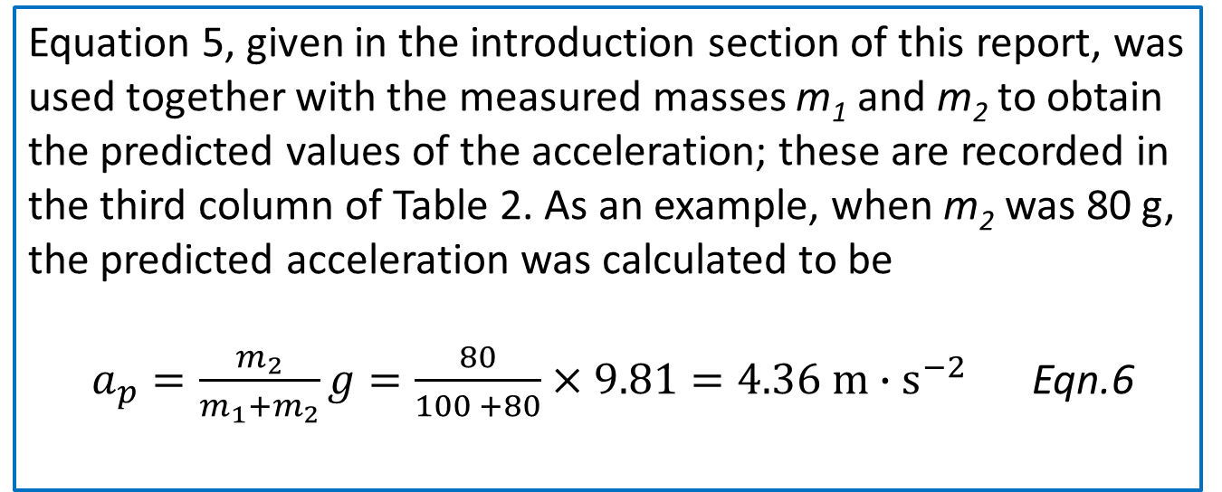
Results: Example
Equation 5, given in the introduction section of this report, was used together with the measured masses m₁ and m₂ to obtain the predicted values of the acceleration; these are recorded in the third column of Table 2. As an example, when m₂ was 80 g, the predicted acceleration was calculated to be
$a_{p}=\frac{m_{2}}{m_{1}+m_{2}}g=\frac{80}{100 +80}×9.81=4.36 m∙s^{−2}$ Eqn.6
Don’t forget to include your units!

Slide 43
Results
You should complete all of the tables in the report template with your measured and calculated values from the experiment.
Tables should always start and finish on the same page.
All your values should be written to an appropriate level of significance (see PPT “Number Handling & Units available” on Moodle).

Slide 44
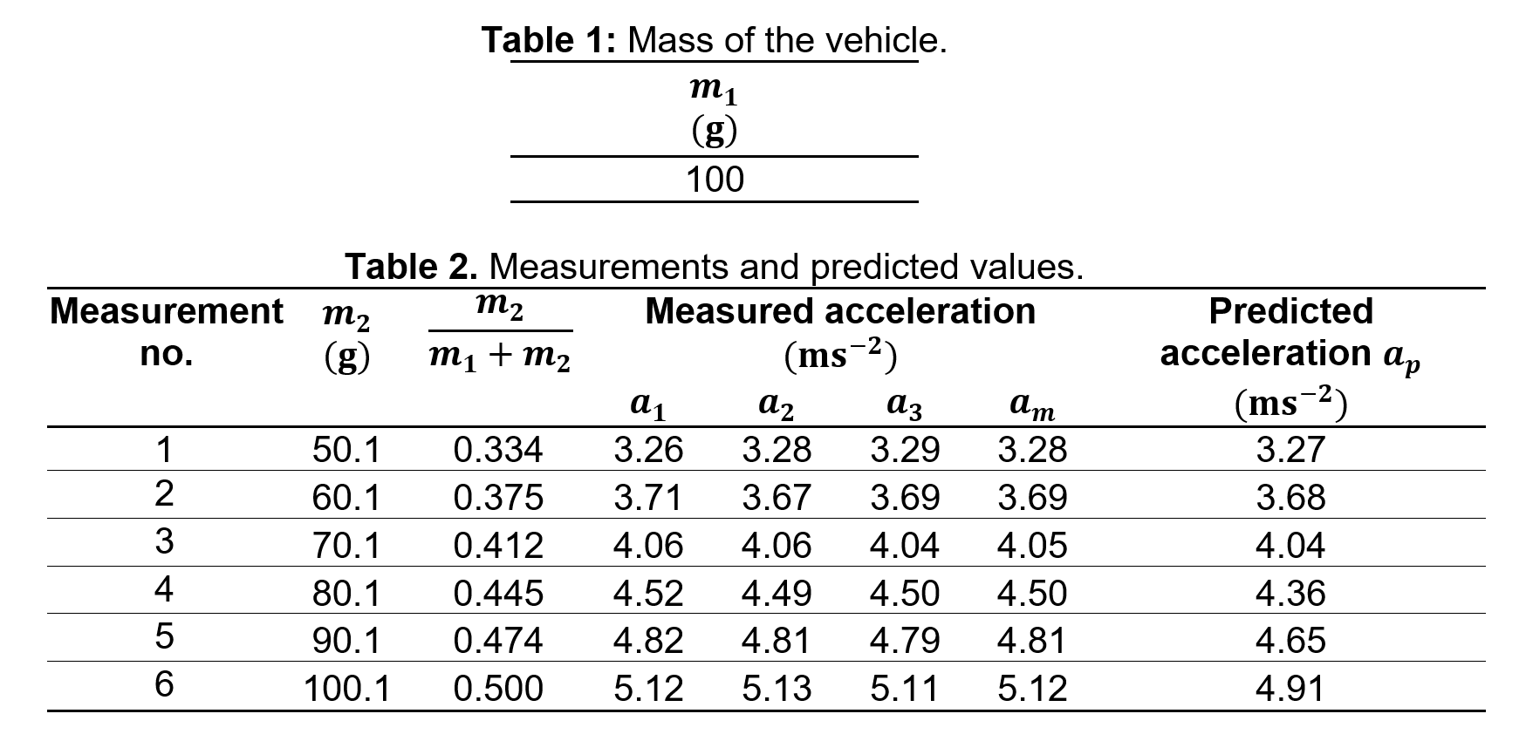
Results: Example
Tables should be centre aligned and labelled above.

Slide 45
Results
You should include any graphs requested by the report template.
There is a separate PowerPoint available on Moodle (called “Representing Data with Excel”) which covers how to produce good graphs, you can find it in the Report Writing section of Science A; however, there are some common criteria for graphs.
Title | Trendline
Data Spread | Equation and R²
Axis Labelled (including units) | Predicted and Measured Results
Appropriate Variables | Uncertainty Error Bars

Slide 46
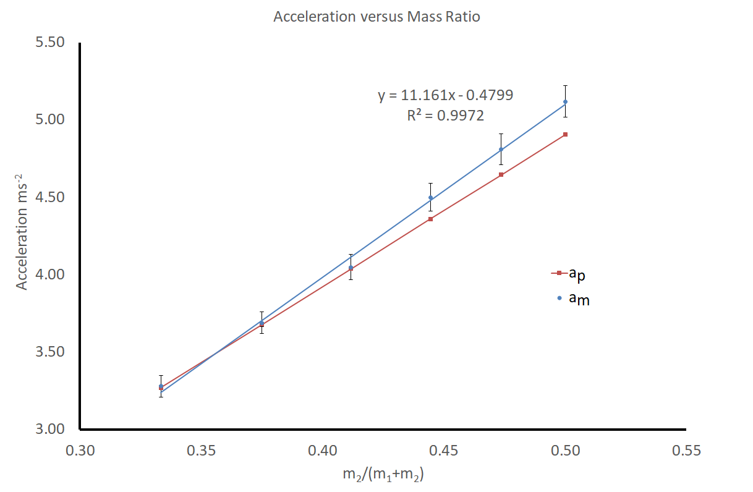
Results: Example
The Graph has a title.
Axis are labelled and have appropriate units.

Slide 47
Results: Example
The data is spread out over the entire graph.
Appropriate variables are plotted on the x and y axis.

Slide 48
Results: Example
Predicted and measured results are shown.
Uncertainty error bars are shown.

Slide 49
Results: Example
A trendline has been plotted.
The equation and R² value of the trendline are shown.

Slide 50
Report Format
Summary
Objective
Introduction
Apparatus
Procedure
Results
Uncertainty Analysis
Discussion
Conclusion

Slide 51
Uncertainty analysis
Much like the results section, there are 2 parts to uncertainty analysis section of the report. In order they are
Sample Calculations
Tables
Uncertainty analysis is a statistical treatment of experimental values, the theory for this will be covered in the Scientific Method module.
For this module, however, you only need to be able to substitute values into a given equation and understand what uncertainty represents.

Slide 52
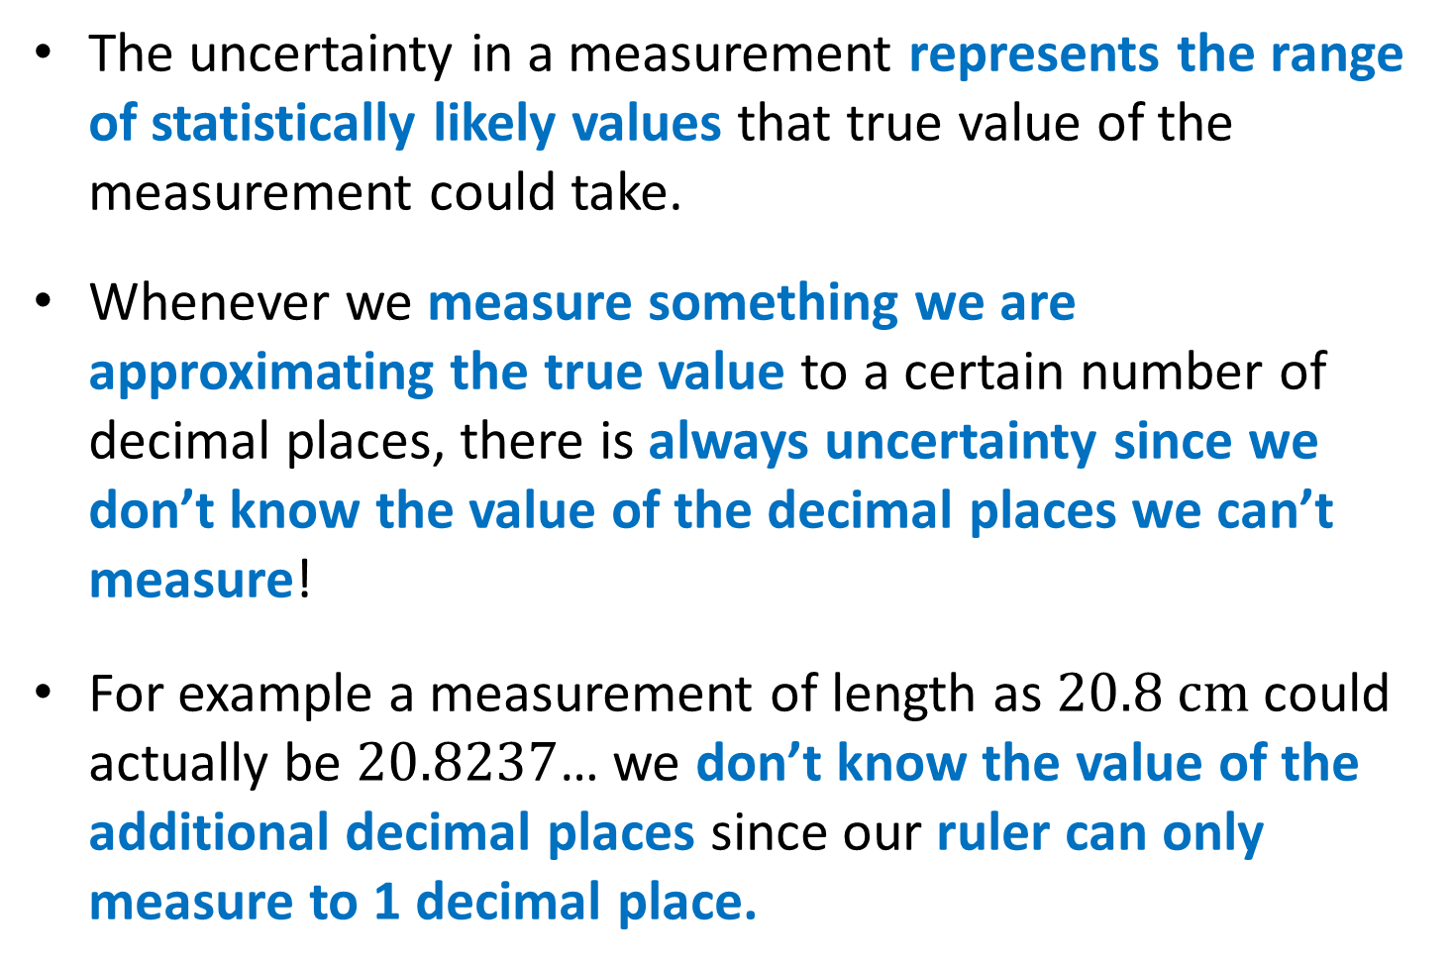
Uncertainty analysis
The uncertainty in a measurement represents the range of statistically likely values that true value of the measurement could take.
Whenever we measure something we are approximating the true value to a certain number of decimal places, there is always uncertainty since we don’t know the value of the decimal places we can’t measure!
For example a measurement of length as $20.8 cm$could actually be $20.8237$… we don’t know the value of the additional decimal places since our ruler can only measure to 1 decimal place.

Slide 53
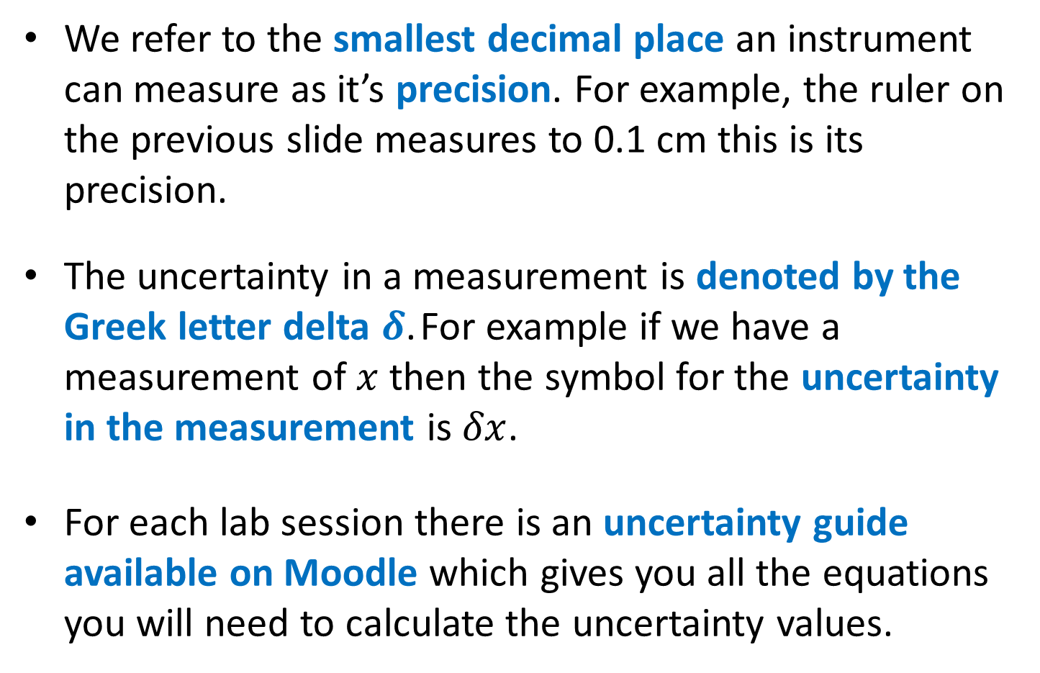
Uncertainty analysis
We refer to the smallest decimal place an instrument can measure as it’s precision. For example, the ruler on the previous slide measures to 0.1 cm this is its precision.
The uncertainty in a measurement is denoted by the Greek letter delta $δ$. For example if we have a measurement of $x$ then the symbol for the uncertainty in the measurement is $δx$.
For each lab session there is an uncertainty guide available on Moodle which gives you all the equations you will need to calculate the uncertainty values.

Slide 54
Uncertainty analysis
The report template will tell you to include some sample calculations (example calculations) to show how you calculate the uncertainty in certain measurements.
A sample calculation should consist of 4 parts;
a brief explanation of what you are calculating,
the formula you are using written algebraically,
the formula you are using with the values substituted in,
and the final value.
We will discuss questions 10) and 11) together so complete the report template as we work through the solutions.

Slide 55
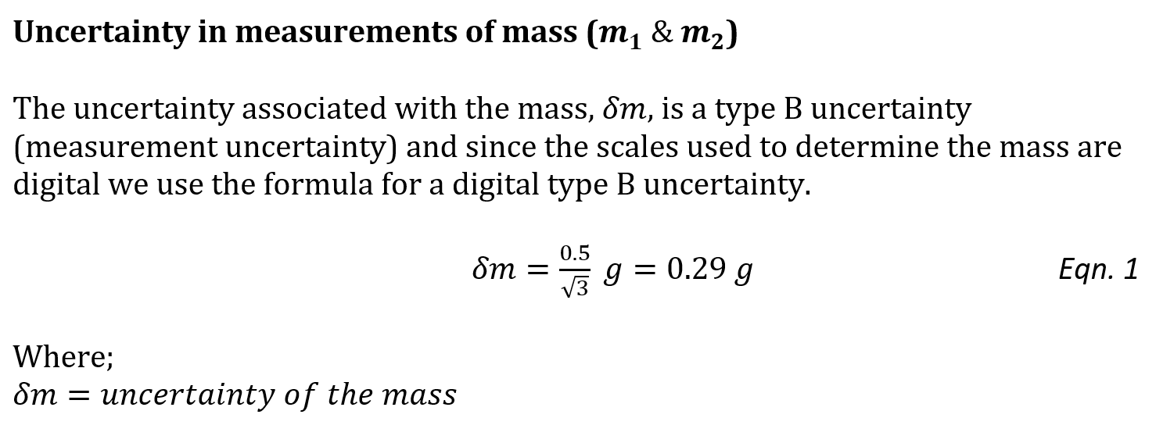
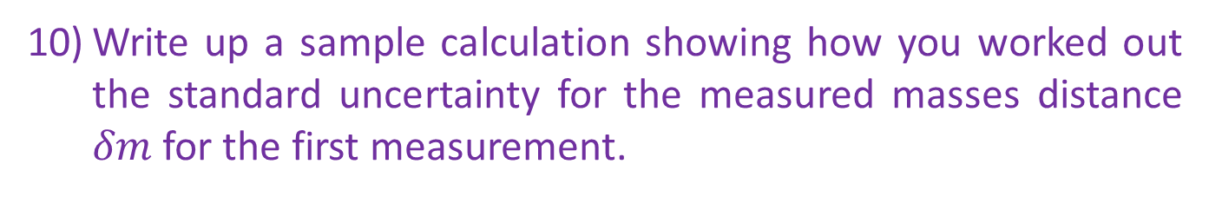
Uncertainty analysis
Write up a sample calculation showing how you worked out the standard uncertainty for the measured masses distance $δm$ for the first measurement.
First we obtain the equation we need from the uncertainty guide on Moodle

Slide 56
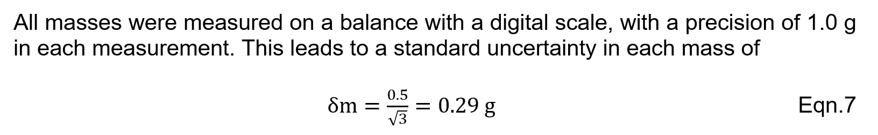
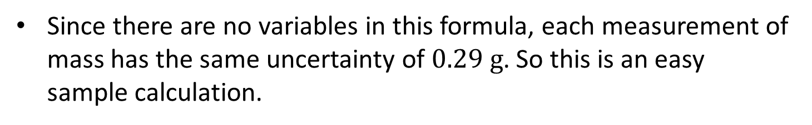
Uncertainty Analysis: Example
Since there are no variables in this formula, each measurement of mass has the same uncertainty of $0.29 g$. So this is an easy sample calculation.
Explanation
Final value
Formula with values
No formula since the equation doesn’t have any variables

Slide 57
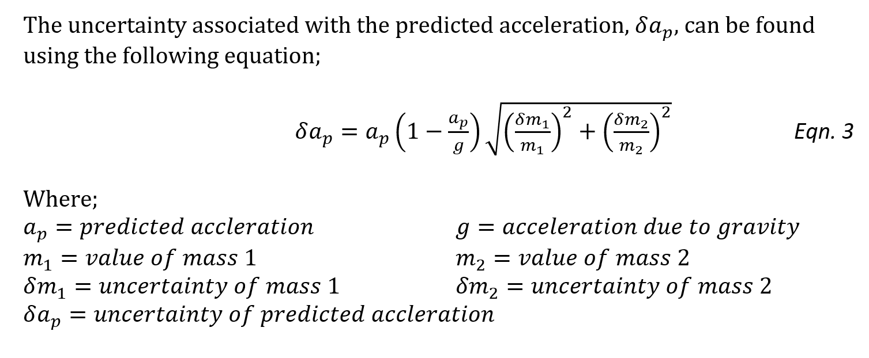
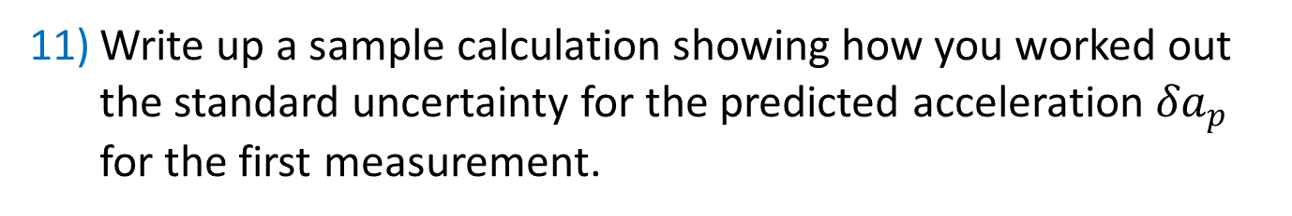
Uncertainty Analysis: Example
Write up a sample calculation showing how you worked out the standard uncertainty for the predicted acceleration ${δa}_{p}$ for the first measurement.
First obtain the equation we need from the uncertainty guide on Moodle

Slide 58
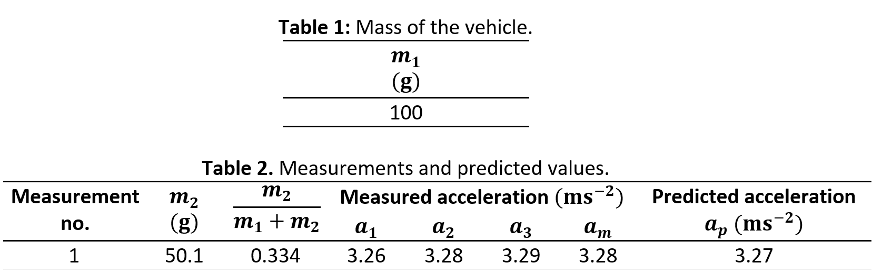
Uncertainty Analysis: Example
Now we just take the values from the relevant tables

Slide 59
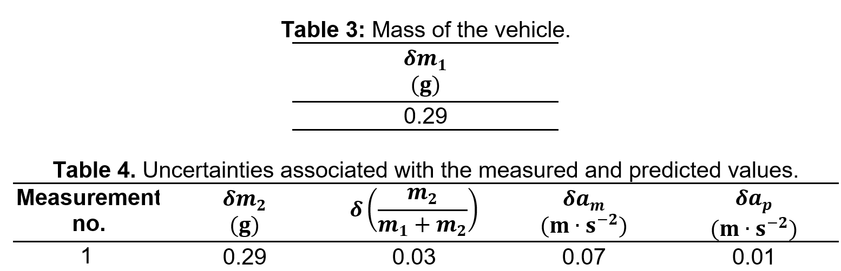
Uncertainty Analysis: Example
Now we just take the values from the relevant tables

Slide 60
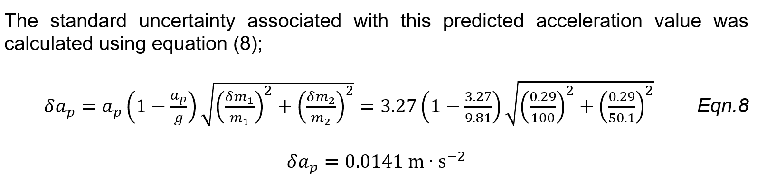
Uncertainty Analysis: Example
Explanation
Final value
Formula
Formula with values
Don’t forget to include your units!

Slide 61
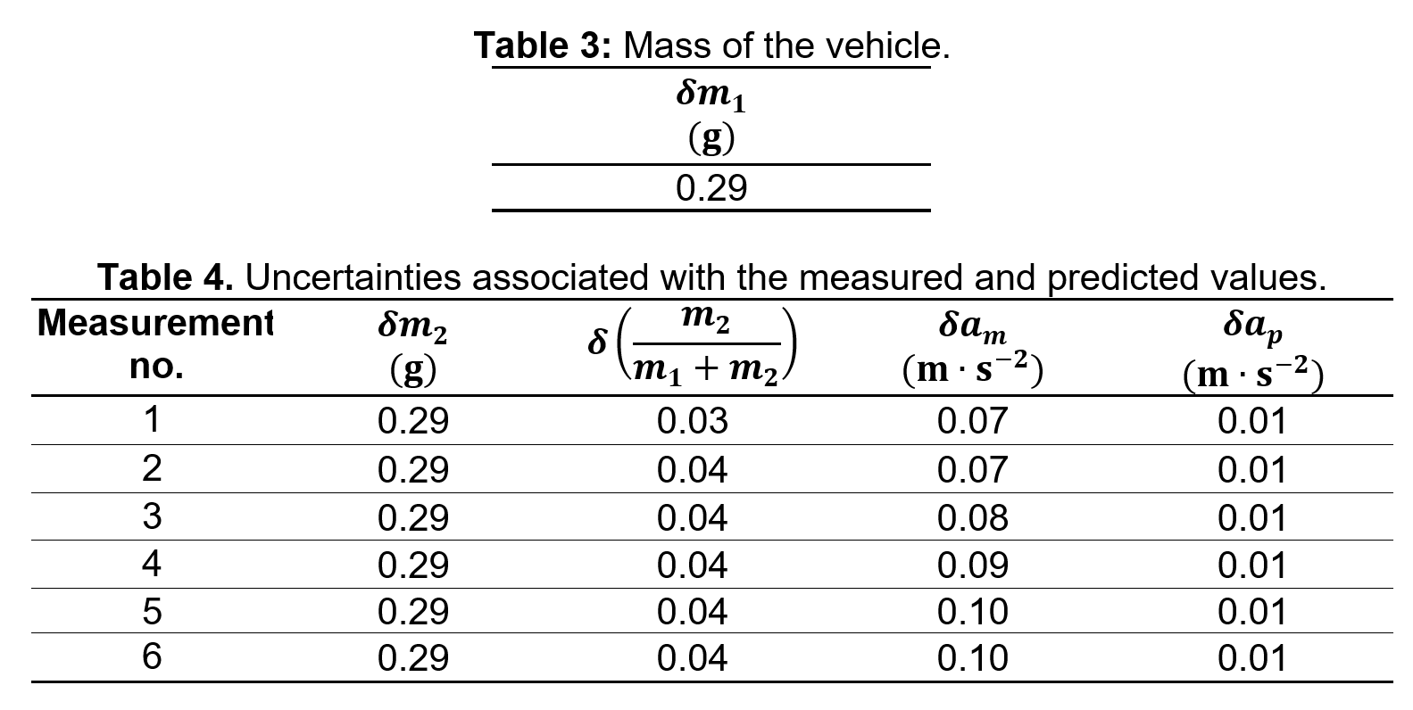
Uncertainty Analysis: Example
Tables should be centre aligned.
Each table must start and finish on the same page.

Slide 62
Report Format
Summary
Objective
Introduction
Apparatus
Procedure
Results
Uncertainty Analysis
Discussion
Conclusion

Slide 63
Discussion
The discussion section of the report is where you need to demonstrate your understanding and ability to interpret the results you have obtained.
The aim of the discussion section is to compare the measured results with the predicted results, do they agree or not? This discussion should include analysis of both the raw data from the tables and any graphs you have plotted.
We will discuss question 12) together so complete the report template as we work through the answers.

Slide 64
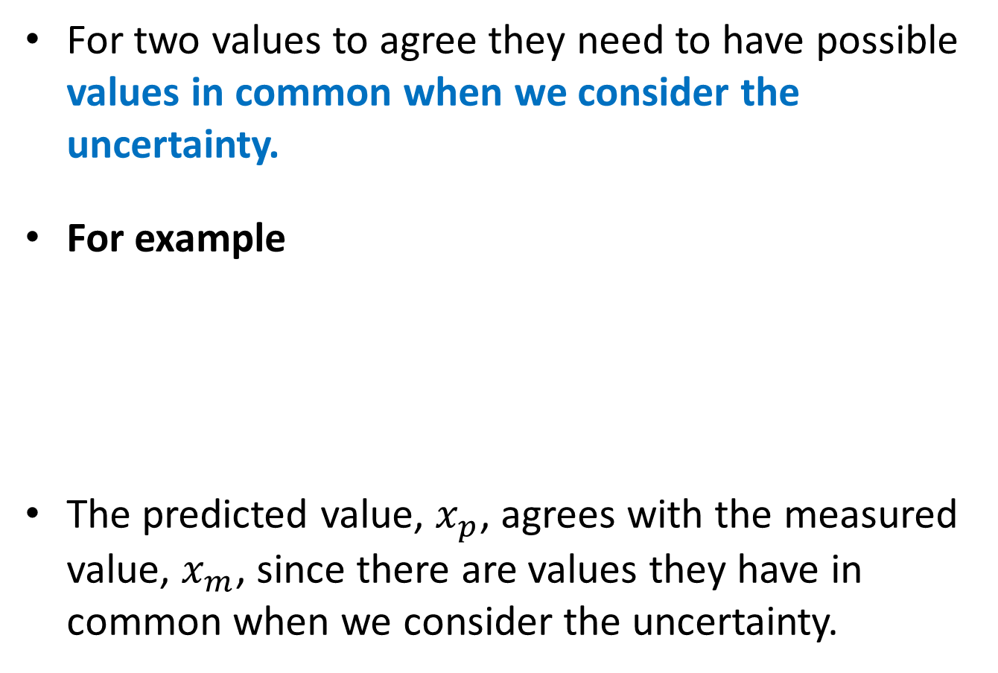




Comparing Values
For two values to agree they need to have possible values in common when we consider the uncertainty.
For example
The predicted value, $x_{p}$, agrees with the measured value, $x_{m}$, since there are values they have in common when we consider the uncertainty.
Value
Uncertainty
$$x_{m}=20.8±0.2$$
$$x_{p}=20.7±0.4$$
$$20.6≤x_{m}≤21.0$$
$$20.3≤x_{p}≤21.1$$

Slide 65
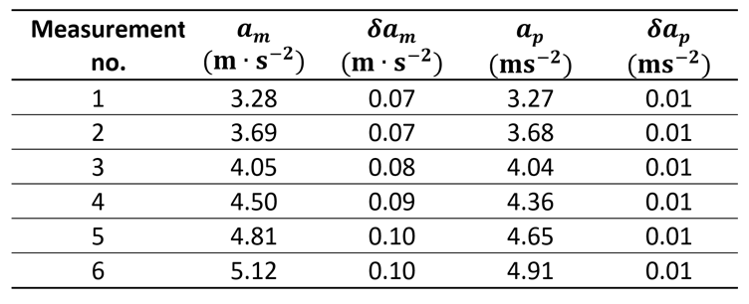


Discussion
How many of the measured results agreed with the predicted results?
So only 3 out of 6 of the measured values agree with the predicted values.

Slide 66
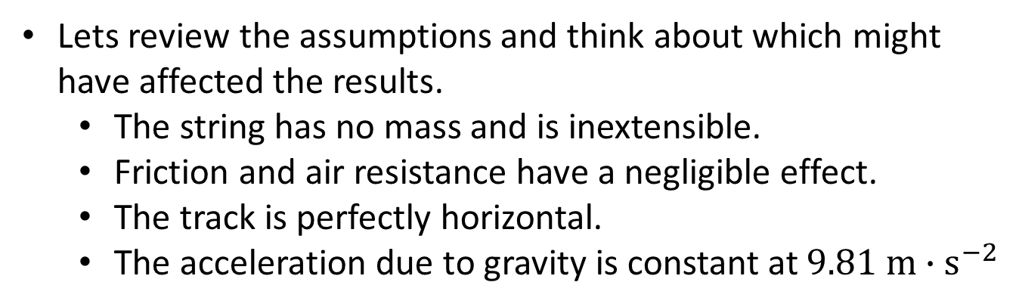
Discussion
For measured results that differed significantly from your predicted results, what are the possible sources of these discrepancies (hint: consider your assumptions)?
There are 3 values that don’t match the predictions, we now have to think about why that might be the case?
Lets review the assumptions and think about which might have affected the results.
The string has no mass and is inextensible.
Friction and air resistance have a negligible effect.
The track is perfectly horizontal.
The acceleration due to gravity is constant at $9.81 m{∙s}^{−2}$

Slide 67

Discussion
For measured results that differed significantly from your predicted results, what are the possible sources of these discrepancies (hint: consider your assumptions)?
The three results which did not agree with predicted values were all larger than expected, therefore the most likely causes of this discrepancy are:
The apparatus might not have been perfectly horizontal, in which case a component of the force due to gravity acting on the vehicle’s mass will have been present.
The assumption that the acceleration due to gravity was constant at 9.81 $m∙s^{−2}$ might not be true, the value could be larger (as it varies across the surface of the planet) which would cause a greater acceleration to be recorded.

Slide 68
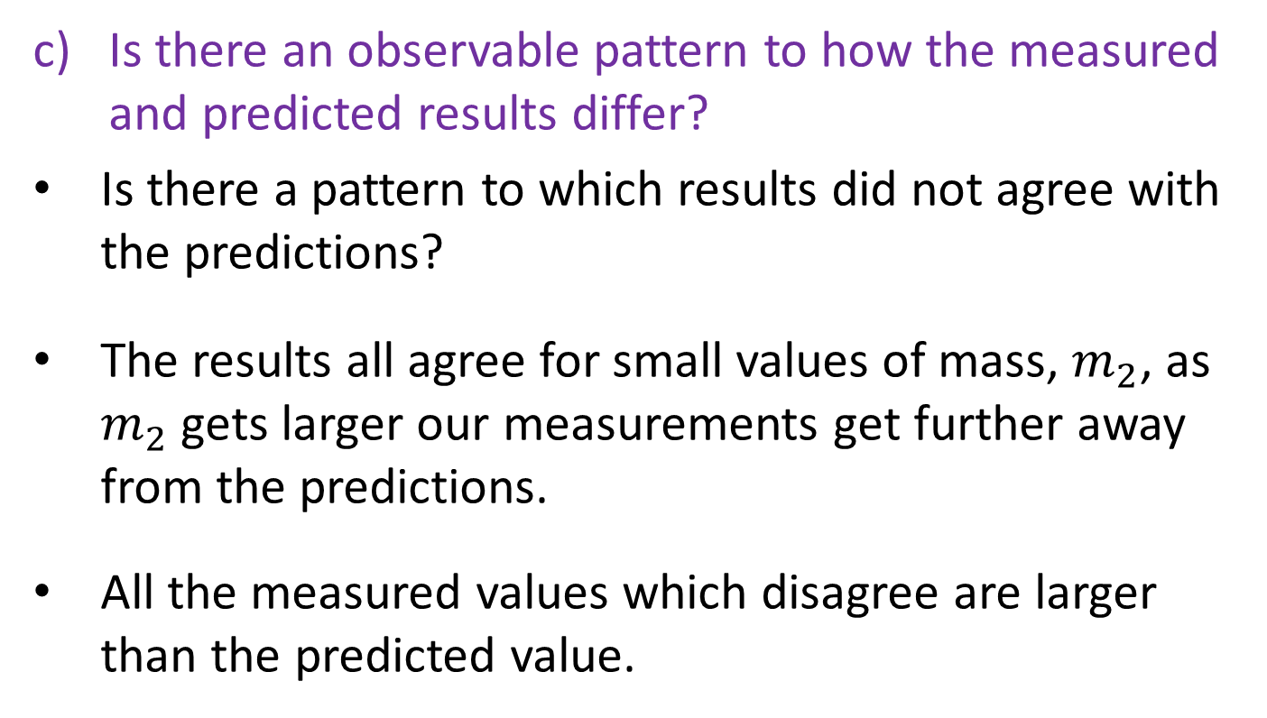
Discussion
Is there an observable pattern to how the measured and predicted results differ?
Is there a pattern to which results did not agree with the predictions?
The results all agree for small values of mass, $m_{2}$, as $m_{2}$ gets larger our measurements get further away from the predictions.
All the measured values which disagree are larger than the predicted value.

Slide 69
Discussion
Overall, do the measured results support your hypothesis or not?
To support the hypothesis we need the majority of the measured values to agree with the predicted values.
Since only half of the results agree with the predicted values there is not enough evidence to support the hypothesis.

Slide 70
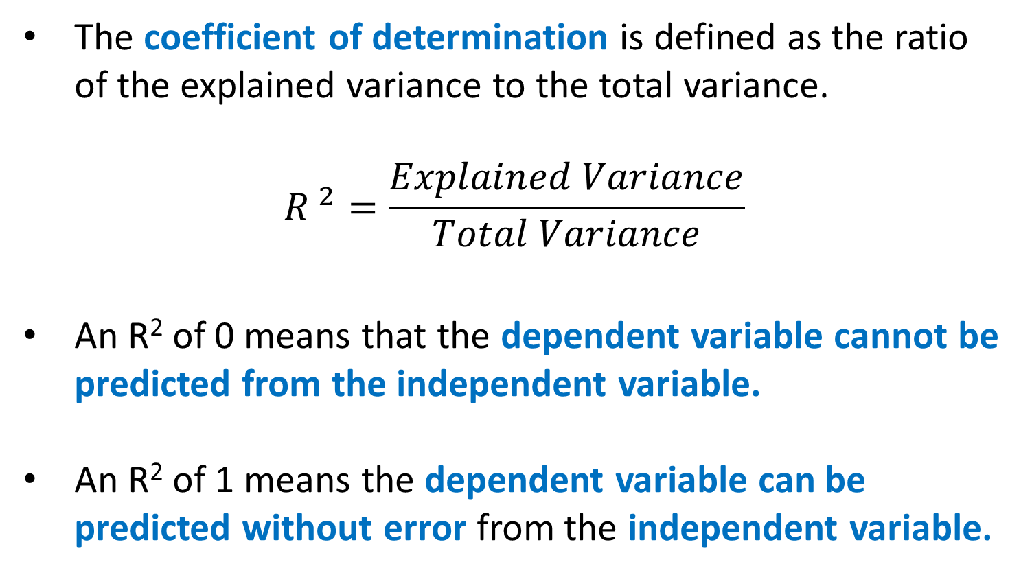
Coefficient of Determination
The coefficient of determination is defined as the ratio of the explained variance to the total variance.
$${R }^{2}=\frac{Explained Variance}{Total Variance}$$
An R² of 0 means that the dependent variable cannot be predicted from the independent variable.
An R² of 1 means the dependent variable can be predicted without error from the independent variable.

Slide 71
Coefficient of Determination
R² varies from 0 to 1 and indicates the extent to which the dependent variable is predictable.
An R² of 0.10 means that 10 percent of the variance in Y is predictable from X.
An R² of 0.20 means that 20 percent is predictable and so on.
So the closer the value is to 1 the better your values fit the trendline.

Slide 72

Discussion
What does the coefficient of determination, $R^{2},$ tell you about the how the variables you have plotted on your graph are related?
The value of the coefficient of determination was found to be 0.9972 which implied that 99.72% variance of y can be explained by x. Thus, there was a strong linear relationship between the vehicle’s acceleration and the dimensionless mass ratio.

Slide 73
Discussion
Does the coefficient of determination support your hypothesis or not?
The coefficient of determination supports the hypothesis as the x and y variables form a very strong linear relationship.

Slide 74
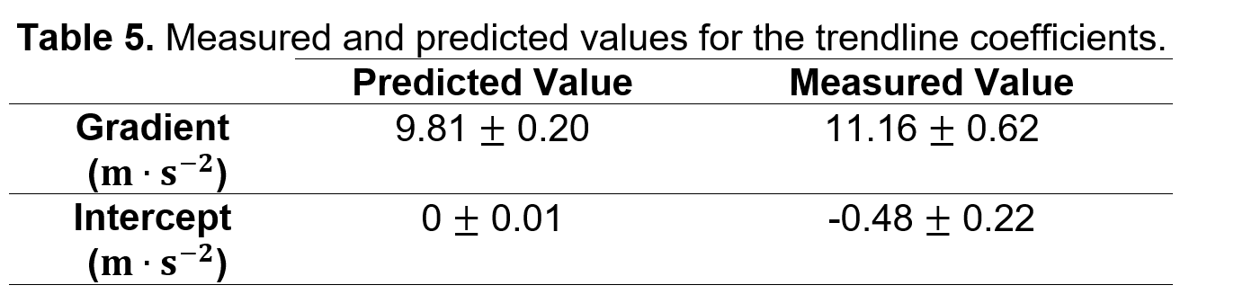
Discussion
Does the trendline you have obtained agree with the prediction (you should reference the values in table 5)?
As shown in table the gradient of the trendline is much larger than the predicted value and is outside the range of uncertainty. The intercept is smaller than the predicted value and is also outside the range of uncertainty. Therefore the trendline for the measured results does not agree with the line predicted by the hypothesis.

Slide 75
Discussion
Do the trendline values support your hypothesis or not?
Since none of the trendline values for the measured results agree with the predicted values, the trendline does not support the hypothesis.

Slide 76
Report Format
Summary
Objective
Introduction
Apparatus
Procedure
Results
Uncertainty Analysis
Discussion
Conclusion

Slide 77
Conclusion
The conclusion section is where you pull together everything you have talked about in your discussion and produce a conclusion about the experiment.
Did the experiment support your initial hypothesis or not?
It is worth mentioning again that it doesn’t matter if the experiment supports the hypothesis or not from a marking perspective. What matters is that you base your conclusion on the evidence you have collected.
If the results don’t support the hypothesis but your conclusion states that they do, then you will score poorly.
We will discuss question 13) together so complete the report template as we work through the answers.

Slide 78
Conclusion
What was the initial hypothesis for the experiment?
In this experiment, the acceleration of a vehicle was investigated to determine whether or not it can be accurately modelled using Newton’s second law of motion.

Slide 79
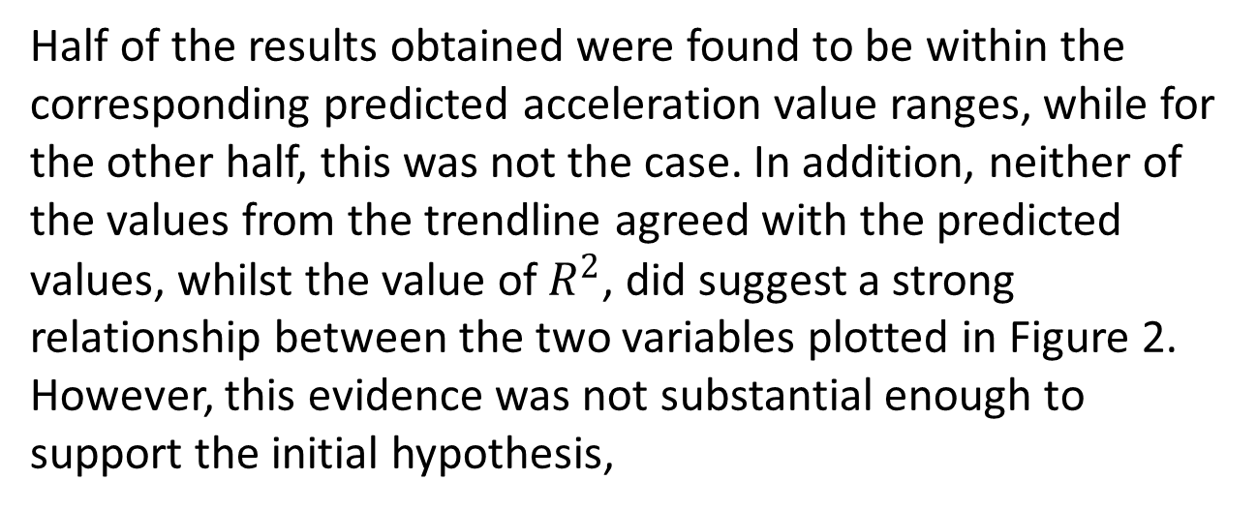
Conclusion
Based on what you have said in the discussion section, does your experiment demonstrate the validity of your hypothesis or not (you should reference directly what you have said in the discussion section)?
Half of the results obtained were found to be within the corresponding predicted acceleration value ranges, while for the other half, this was not the case. In addition, neither of the values from the trendline agreed with the predicted values, whilst the value of $R^{2}$, did suggest a strong relationship between the two variables plotted in Figure 2. However, this evidence was not substantial enough to support the initial hypothesis,

Slide 80
Conclusion
Which of the factors from the discussion section is the main source of any measured results differing from predicted results?
The main factor which affected the results was most likely to be the apparatus not having been setup perfectly horizontal which would have caused the force component due to gravity increased the vehicle’s acceleration.

Slide 81
Conclusion
What improved experimental techniques or mathematical models could account for these discrepancies in future investigations?
This experiment could be further improved by;
using a spirit level to ensure that the air track was perfectly horizontal
obtaining an accurate value for the local acceleration due to gravity
taking in to account the effect of air resistance in the mathematical model.

Slide 82
Report Format
Abstract
Objective
Introduction
Apparatus
Procedure
Results
Uncertainty Analysis
Discussion
Conclusion

Slide 83
Abstract
What is the hypothesis for this experiment?
In this experiment, the acceleration of a vehicle was investigated to determine whether or not it can be accurately modelled using Newton’s second law of motion.

Slide 84
Abstract
What was done during the experiment? Try to keep this short (two or three sentences).
A weight falling under gravity was coupled to a vehicle of known mass to provide a constant acceleration. The procedure was repeated with weights of different masses. The acceleration was measured using a light gate and compared with the value predicted by Newtonian mechanics.

Slide 85
Abstract
How may results agreed with predictions? Overall do the results of the experiment support the hypothesis?
The predicted accelerations were only found to agree with the measured accelerations for half of the results, when uncertainties from measurement and modelling assumptions were considered and therefore these experimental results could not be used to support the hypothesis.

